Slide 1
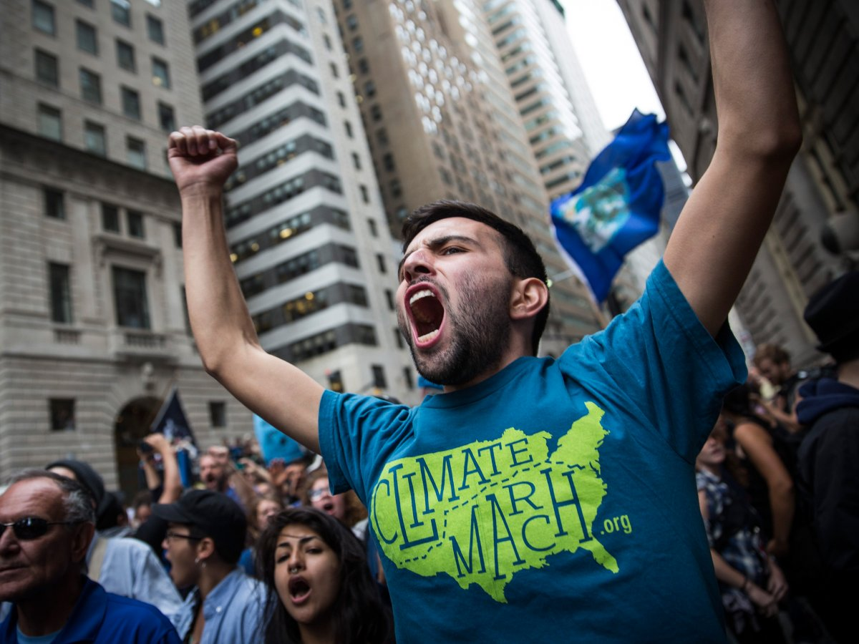
10. Lack of economic opportunity and unemployment (14.2%)
9. Food and water security (15.1%)
8. Lack of political freedom and political instability (15.5%)
7. Lack of education (16.5%)
6. Safety, security, and well being (18.1%)
5. Government accountability and transparency, and corruption (21.7%)
4. Poverty (31.1%)
3. Religious conflicts (33.8%)
2. Large scale conflict and wars (38.5%)
1. Climate change and destruction of natural resources (45.2%)
-2016 Global Shapers Study - World Economic Forum
Notes:
70% of millennials see plentiful opportunities for themselves and their peers, and 50% believe they can significantly contribute to decision making in their home country.
which surveyed more than 26,000 millennials from 181 countries to gauge the priorities, concerns, and attitudes of millennials around the globe.

Slide 3



